Slide 1
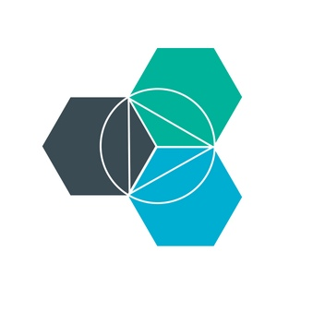
Bluemix Enablement IBM Internal Only
July 29, 2015
Clinton May
Bryna Dash
Federal Cloud Software

Slide 2
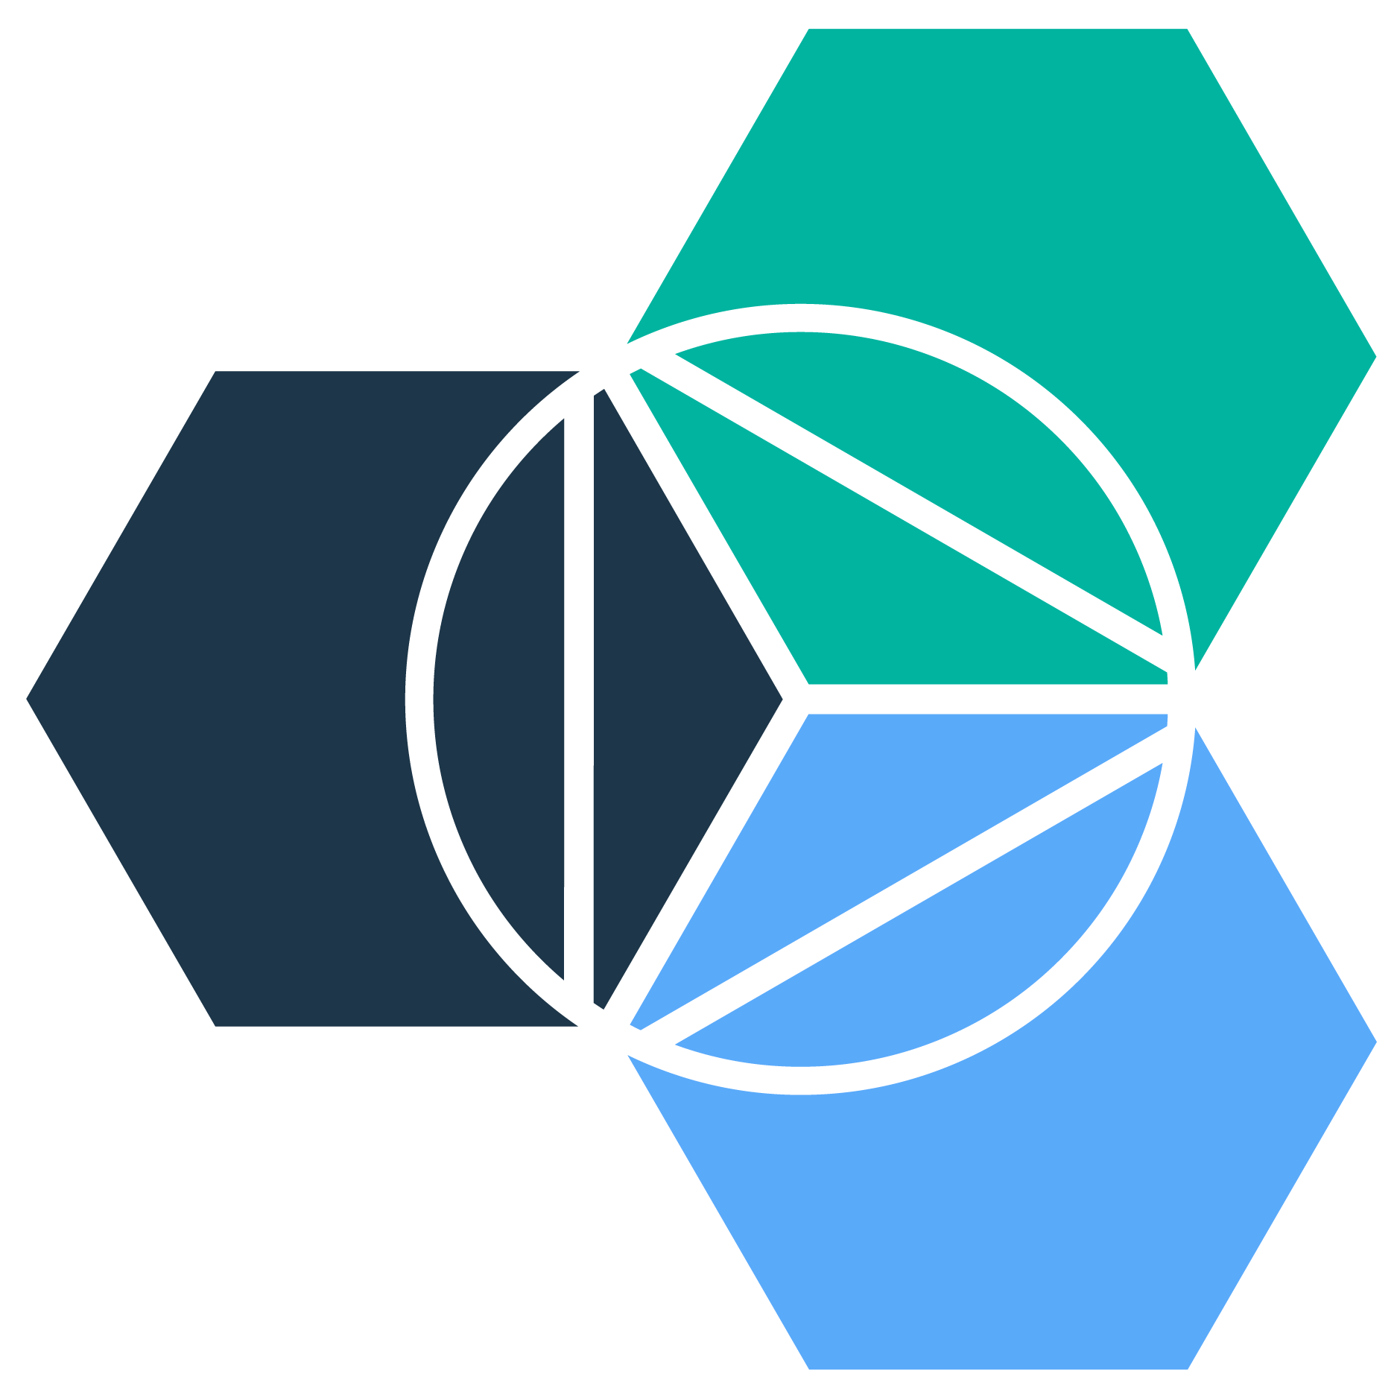

PaaS: Platform as a Service
Bluemix started with a focus on developer productivity in the public cloud
Customer Managed
Service Provider Managed
Infrastructure as a Service
Platform as a Service
Code
Code
Data
Data
Runtime
Runtime
Middleware
Middleware
OS
OS
Virtualization
Virtualization
Servers
Servers
Storage
Storage
Networking
Networking

Slide 3



Developers and businesses choose PaaS for:
Innovation: Experiment with speed. Focus on differentiation and mission success.
Demos & conferences
IR&D & contract innovation
Initial development
Agility: Extend existing IT investments into cloud business and delivery models.
Multi-Cloud vendor environments
iFUNDLM
Hackathons and App Challenges
data.gov
Velocity: Rapidly bring new products and services to market at lower cost.

Slide 4
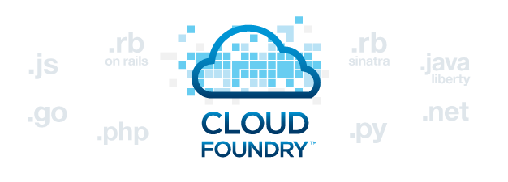


Why Bluemix?
Bluemix is an open-standards, cloud-based platform for building, running, and managing applications.
How BMX Works 2014
How BMX Works 2015

Slide 5
Executive
Why Bluemix?
Bluemix is an open-standards, cloud-based platform for building, running, and managing applications.
Bring the Innovation in-house
Capture the value your developers are creating out of view. Establish an enterprise framework that allows developers to use their tooling of choice. Monetize the innovation for new revenue streams.
Avoid rip & replace
Extend apps to the Cloud (for cost & functional advantage) without rewriting current investments, and without exposing sensitive datasets.
Shift from Capex to Opex
Only pay for what you use. Gone are the days of large initial capital outlays. Try (often for free) and iterate. Price transparency with no hidden costs.
Zero Lock-in
Portability of apps, services and data. Ability to change vendors for business and/or costs advantage.
Time to Value
Get new capability to market faster. No setup time or prerequisites.
5

Slide 6
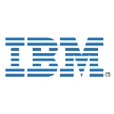
Application Development Director
Why Bluemix?
Bluemix is an open-standards, cloud-based platform for building, running, and managing applications.
Attract & keep dev talent
Allow developers flexibility in tooling – to pick the best runtime, APIs, IDE for the job at hand, but maintain an enterprise framework for reuse, collaboration and manageability.
Hybrid Cloud
Extend apps to and across Clouds to access the best services available (Watson, Sentiment, etc.) – and, without rewriting current investments.
Time to Value
Get started immediately. Spend precious dev resources on the mission function vs. the ‘plumbing.’
No wait on IT Ops for setup.
Zero Lock-in
Portability of apps, services and data. Ability to move as the Cloud space continues to evolve.
Low cost iterations
Only pay for what you use. Try (often for free) and iterate.
6

Slide 7
Developer
Why Bluemix?
Bluemix is an open-standards, cloud-based platform for building, running, and managing applications.
Build your apps, your way
Use the most prominent compute technologies to power your app: Cloud Foundry, Docker, OpenStack.
Deploy and manage hybrid apps seamlessly
Get a seamless dev and management experience across a number of hybrid implementations options.
Scale more than just instances
Development, monitoring, deployment, and logging tools allow the developer to run and manage the entire application.
Flexible Pricing
Try compute options and services for free and, when you’re ready, pay only for what you use. Pay as you go and subscription models offer choice and flexibility.
Extend apps with services
A catalog of IBM, third party, and open source services allow the developer to stitch an application together quickly.
7
7

Slide 8
Developers and businesses choose PaaS for:
Innovation: Experiment with speed. Focus on differentiation and mission success.
Demos & conferences
IR&D & contract innovation
Initial development
Agility: Extend existing IT investments into cloud business and delivery models.
Multi-Cloud vendor environments
iFUNDLM
Hackathons and App Challenges
data.gov
Velocity: Rapidly bring new products and services to market at lower cost.

Slide 9


Innovation
Small business working with DARPA on smart drones
Integrate real time weather data (from our alliance with Weather Channel) with other analytics
Make drones aware of their surroundings (both of weather patterns and updates on target locations/battlefield conditions)
Have drones make their own decisions on flight paths
Make drone fleets even more capable, efficient and cost effective
“I want to cheaply prototype and iterate new PoCs for customers.”
I want to harness the innovation of my workforce. – iFundLM
DARPA Smart Drones

Slide 10

Agility
Disruptors working with agencies on advanced services for analysts
Leveraging Watson services to help with analysis of open source data (OSINT – open source intelligence)
Craigslist adds used by Al-Shabaab to sell illegally poached wildlife – which is 60%+ of the terror group’s income
Leverage Bluemix as an ‘integration hub’ for services across projects
Human trafficking apps with reverse geo-coding
Platform that can handle everything from initial prototype development through test to production.
“I want a platform where our developers can build new applications, change them (depending on feedback from clients) and repackage them to sell to other clients with similar needs.”
“I want to be a valuable sub on large contracts.”
Human Trafficking App
Notes:
Jessica Thomas

Slide 11


Agility
Disruptors working with agencies on advanced services for analysts
Leveraging Watson services to help with analysis of open source data (OSINT – open source intelligence)
Baltimore riot prototype went from concept to live demonstration in 2 weeks
Leverage Bluemix as an ‘integration hub’ for services across projects and across Clouds
Platform that can handle everything from initial prototype development through test to production.
“I want a platform where developers can build new application components and share them across projects, regardless of the individual tooling choices on each project.”
“I want to add new functionality to my existing applications.”

Slide 12
Velocity
Disruptors working with agencies on advanced services for analysts leverage speed as their competitive differentiator
Leverage Bluemix as an ‘integration hub’ for services across projects and across Clouds – reuse enables speed
Platform that can handle everything from initial prototype development through test to production – devops inside of Bluemix enables speed
Leidos went from concept to initial demo in 3 weeks – showed at SOFIC – and - LM went from concept to demo at GEOINT in 2 weeks
“My team does not have 6-9 months to work on this new app idea.”
“My team is using Cloud services on their own, and there is no Enterprise visibility/control of these ad hoc toolkits.”

Slide 13



Sales Tools
Speedboats that use Internet of Things devices to inform and make real time decisions: https://www.youtube.com/watch?v=rpsjxnoNc-u
Using Open Source Data and Bluemix to increase access and usability of data, while also providing ‘value added’ analytics and visualization:
https://www.youtube.com/watch?v=08UjaszuGCk&list=PLh9e82xViX4bF5LlsYUcyu26YG7GM7i3S
Notes:
Coastal data at FEMA

Slide 14
Competition

Slide 15
DevOps Features: Unique features go well beyond AWS PaaS features: e.g. Delivery Pipeline, Track & Plan. Offers control over the entire app lifecycle. Bluemix DevOps experience is a common UI built from the ground-up with developers in mind
Integration Tools: Few clients of any size live exclusively in cloud. Bluemix offers Cloud Integration tying cloud to systems of record
Team Development: Bluemix’s DevOps features facilitate team development
Choice/Built on open, with enterprise quality: AWS services work best with other AWS services and APIs, creating lock-in. Google services and cloud basis are proprietary. IBM provides services based on open standards, giving choice
Amazon / AWS
Google
Bluemix Battlecards

Slide 16
Pivotal
Bluemix strengths over Pivotal are mobile services and devops built-in
Pivotal sells on-premise and is also based on Cloud Foundry
Microsoft Azure
OpenShift

Slide 17
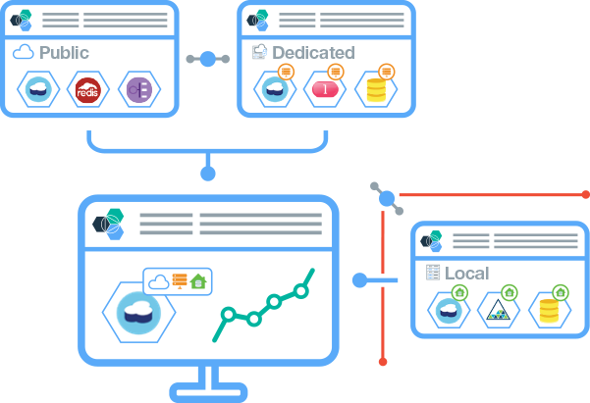
Multiple delivery options providing a seamless user experience.
2 | Dedicated
Everything is dedicated and connected to you — agility of public cloud, yet feels like home.
1 | Public
Maximize on cloud economics and agility.
3 | Local
Behind the firewall for the most sensitive workloads.
Regardless of which combination you choose, you can expect a single, seamless experience.

Slide 18
Call to Action
August 5th Bluemix Day
Technical Briefings
Company-specific Bluemix Days
Hackathons

